Slide 1

Fire Safety: Coordination and Control
Project by: Error Squad Topic: Fire Safety Organization

Slide 2

TABLE OF CONTENTS
01
02
OUR TEAM
OUR GOAL
03
04
STAGES OF REALIZATION
USED
TECHNOLOGIES

Slide 3
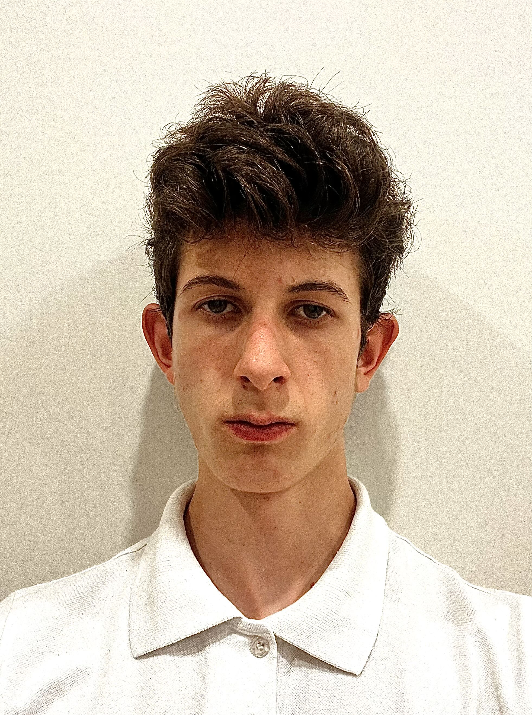
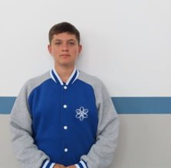
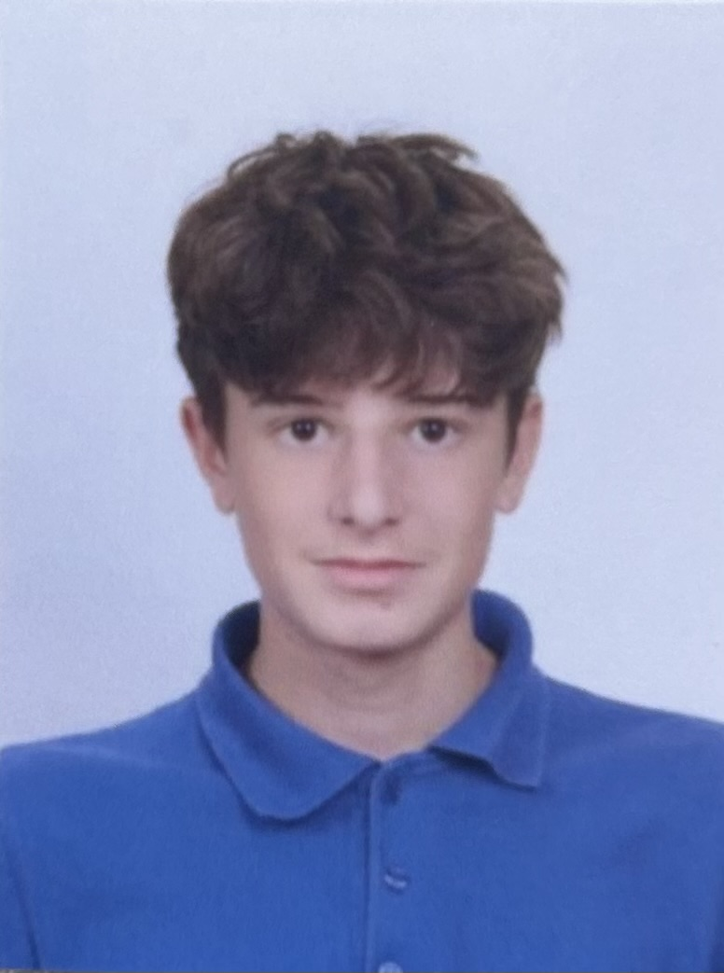
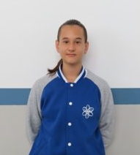
OUR TEAM
Alexеy Atanasov
Denis​
Zavalishin​
Danail Petrov
Svyatoslav Sidorov
Scrum Trainer
Front-end
developer
Back-end
developer
Designer

Slide 4

OUR GOAL
The goal of our project is to design and implement a web-based information system that supports the daily operational activities of fire safety services. This system provides detailed data about firefighters, fire trucks, fire extinguishing equipment, and incident management. It allows users to report emergencies, track team availability, and visualize real-time response efforts on an interactive map.
Through this platform, we aim to enhance coordination, improve data accessibility, and support decision-making for firefighting units in a specific region. Our mission is to contribute to public safety by offering a functional and intuitive digital tool built with HTML, CSS, and JavaScript.

Slide 5
STAGES OF REALISATION
ORGANISATION​
DECIDE ON THE IDEA​
DEVELOPMENT
PRESENTATION

Slide 6






USED TECHNOLOGIES

Slide 7
THANK YOU FOR THE ATTENTION! LET'S CONTINUE WITH THE PROGRAMM

